Slide 1
MULTIMEDIA: THE ELEMENTS
Typography

Slide 2
A Brief Look at Typography
At one time, all web content was disseminated with text.
Although graphics and other media elements have since been added, text is still the primary vehicle for communicating.
Similar to the way text is used in print, text on web pages is used for headlines, subtitles, captions, and body copy.
In addition to being the primary type of online content, text is also used as anchor text for hyperlinking; it links content and concepts within as well as between web pages.

Slide 3
A Brief Look at Typography
Essentially meaning that, text-based menus and buttons provide navigational tools that help guide users through their online experience.
Similarly popular web-based products, such as electronic books, magazines, and reference materials, use text to inform and educate.
Typography is more than 300 years old. Since its inception, many aspects to type design have evolved and grown into an expansive collection of knowledge.
Type design is an incredible art form and a wonderful communication tool.

Slide 4
A Brief Look at Typography
The effective use of text on web pages is dependent upon typography and the typefaces used.
Typography is type design; it is the typeface used and the way the type is arranged to communicate an idea.

Slide 5
Typefaces VS. Fonts
TYPEFACE: A typeface is a set of characters that all follow the same rules within the set.
This is usually made up of alphabet letters, numerals, and symbols.
FONT: A font is a set of characters within a typeface that has specific characteristics associated with it.
This refers to the size (the height of the characters), weight (how dark the characters appear), and style (such as italic/oblique, condensed, extended, etc.).

Slide 6
Typefaces VS. Fonts
Back in the good ol’ days of analogue printing, every page was laboriously set out in frames with metal letters. That was rolled in ink, and then it was pressed down onto a clean piece of paper. That was a page layout.
Printers needed thousands of physical metal blocks, each with the character it was meant to represent set out in relief (the typeface).
If you wanted to print Garamond, for example, you needed different blocks for every different size (10 point, 12 point, 14 point, and so on) and weight (bold, light, medium).
www.fastcodesign.com

Slide 7
Typefaces VS. Fonts
This is where we get the terms typeface and font.
In the example, Garamond would be the typeface: It described all of the thousands of metal blocks which had been designed with the same basic design principles.
A font described a subset of blocks in that very typeface — but each font embodied a particular size and weight. For example, bolded Garamond in 28 point was considered a different font than normal Garamond in 30 point, and italicized Times New Roman at 24 point would be considered a different font than italicized Times New Roman at 28 point.
www.fastcodesign.com

Slide 8
Typefaces VS. Fonts
The distinction between the two terms, and the processes they encapsulated, got muddied with the rise of desktop publishing.
DOES IT EVEN MATTER ANYMORE?
Even among type professionals, there's a growing acceptance that for most people, the terms font and typeface can be used interchangeably.
Only experts really need to worry about it.
Though, these definitions aid in understanding the various syntax terms used in HTML.
www.fastcodesign.com

Slide 9
WTFont has that got to do with me?
Good typography is as important on a web page as it is on paper. Text should be easy to read and visually pleasing, and one of the many challenges of using text on a web page is getting the message across in an exciting, creative, and visual way.
Meeting this challenge means recognising how text is used differently on the web than in print.
Although the results need to be the same, print and web typography are very different from each other.

Slide 10
WTFont has that got to do with me?
WHY?
Simply put, web designers need to design for computer screens of various sizes and resolutions, which comes with its own unique set of issues.

Slide 11
WTFont has that got to do with me?
People who work with print know that when the copy is printed, it does not always print the way it looked on screen in a desktop publishing program.
This difference in print material can occur for a number of reasons: the printer may not be properly calibrated, which means the colour may be off-register and print outside the intended image, making text blurry, or the text may bleed on the paper.
The print designer can correct these problems and end up with a printed piece that remains consistent each time it is printed.

Slide 12
WTFont has that got to do with me?
A web designer, however, does not have this luxury.
The web is an elastic medium that must work across different computer platforms, screen sizes, and available font sets.
As a digital designer, it will be your job to understand these issues and to try to control them or at least minimize their negative impact.

Slide 13
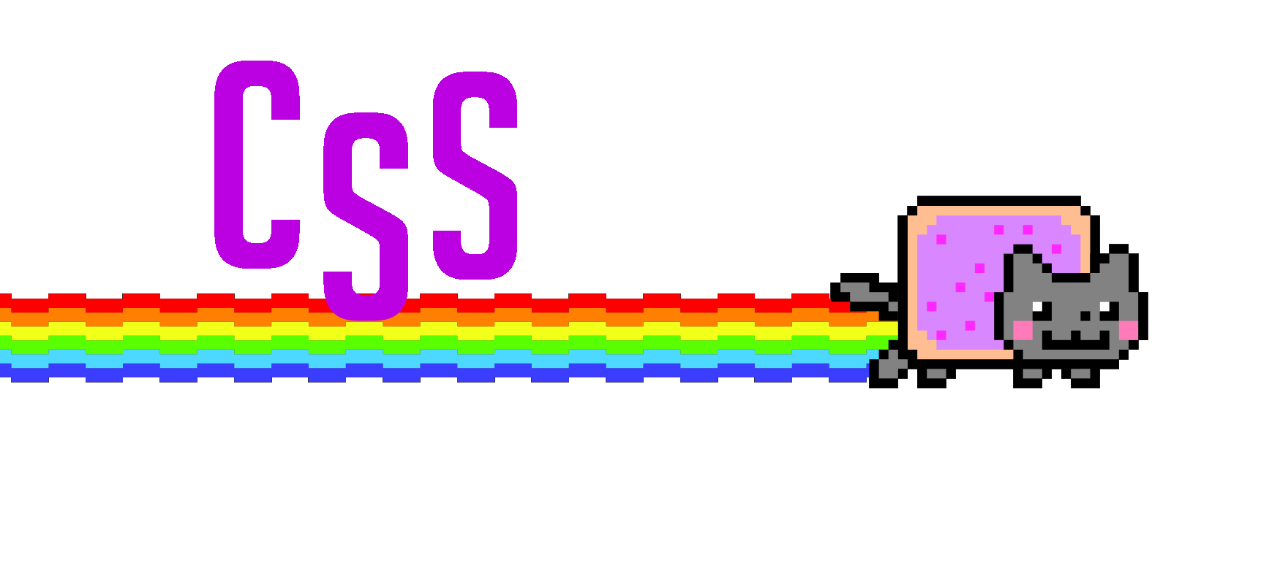
WTFont has that got to do with me?
The advent of Cascading Style Sheets (CSS) has in many ways solved some of the issues of typefaces rendering across platforms.

Slide 14
WTFont has that got to do with me?
When your content is mostly text, the way you use typography to create readable and visually interesting text is of paramount importance.
You must understand many issues to effectively control how text appears on the web. For example, users may not have the fonts you specify in your XHTML document installed on their computers.
This means that if you use fonts haphazardly, what you see on your screen may not be anything close to what your users see on their screens.

Slide 15
WTFont has that got to do with me?
Although readability is a vital part of type design, most web designers also want the ability to use different fonts to help create the desired look and feel of the site for the target audience.
Different fonts, when used properly, can help focus attention on certain text on the screen, enhance readability, set a tone (serious, light-hearted), and project an image (progressive, conservative).

Slide 16
WTFont has that got to do with me?
There are default fonts that come pre-installed with each operating system.
See below for a list of common default fonts currently pre-installed computers, and unless a user has specifically deleted a default font, these default fonts will be available for displaying text on a web page.

Slide 17
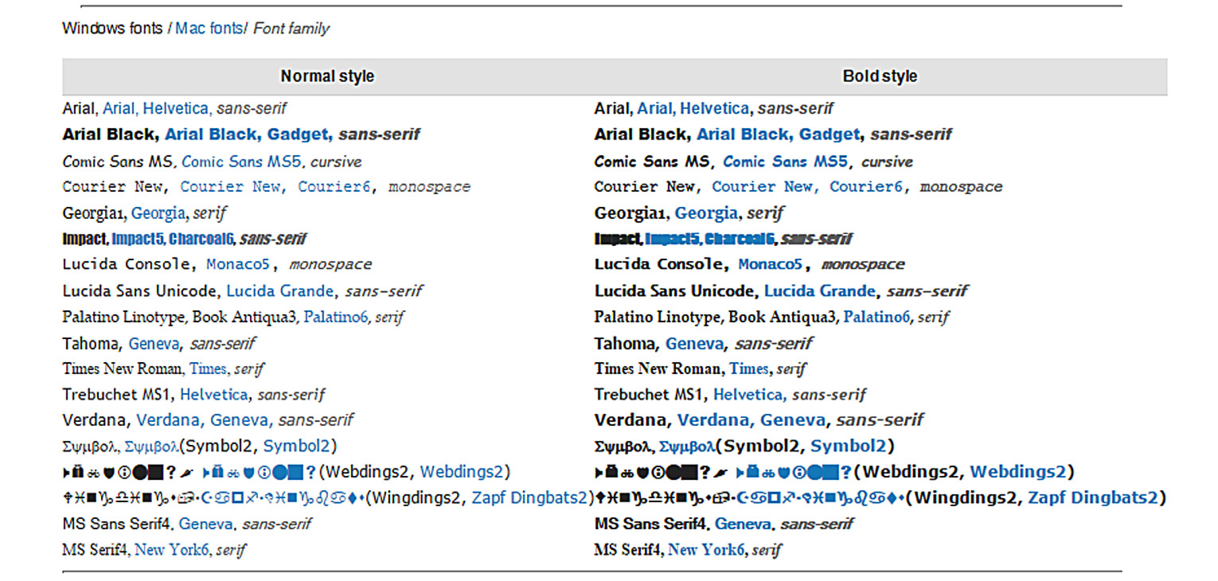
QUICK TIP: Use default fonts to maintain consistency and obtain a certain degree of insurance that the text will appear on the Web page as you intended.
As you work with fonts, you will probably begin to recognize which fonts are the more commonly used default fonts. You can also view the fonts installed on a specific computer from the Fonts folder on a computer. The Fonts folder is located in the Windows folder on a PC and in the System folder on a Mac.

Slide 18
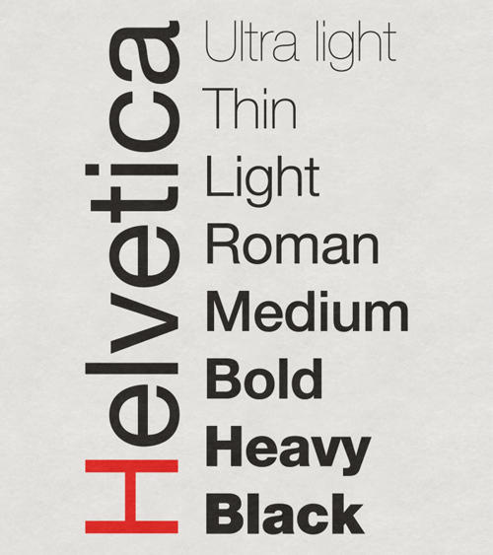
That’s FONTastic!
In addition to the operating system installing default fonts, most software programs come with default fonts that are installed when the programs are installed.
To further complicate matters, font sets can be downloaded from the Internet or purchased. Type designers often sell their fonts or offer royalty-free options with licensing criteria.
Remember that fonts are original creations.
If you purchase the rights to use the font, be sure to read the licensing agreements very carefully. If you do not purchase the rights to use the font, make certain it is royalty free.

Slide 19
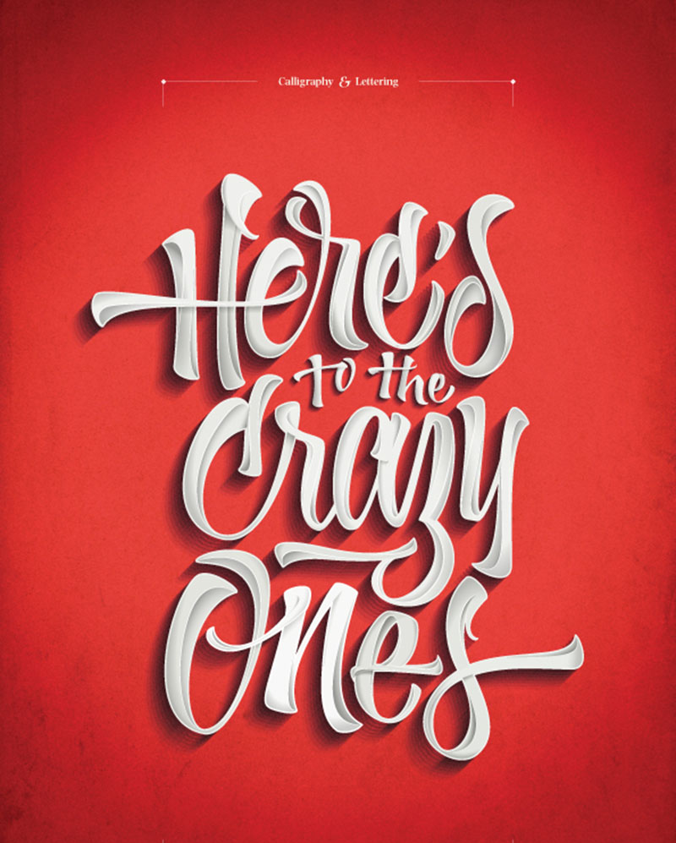
I Know Your TYPE!
Good typography is anything but boring. There are literally hundreds of thousands of fonts on the market today. Slight differences between two fonts can create vast differences in the look and feel of a website.
There are times when it is difficult to describe what distinguishes one font from another in technical terms, yet fonts often have a certain look or feel associated with them – in much the same way that colours often have emotions associated with them.

Slide 20
I Know Your Typeface!
Fonts are classified as either serif, sans serif, or decorative.
Serif fonts have feet or short lines at the ends of the strokes of the letter, whereas sans serif fonts do not. Sans means “without”, so a sans serif font is one without serifs or without feet.
A decorative font may have a combination of serif and sans serif fonts or it may be one that cannot be categorized either way.
Perhaps the overriding concern with text is readability. In print, serif fonts are used for long or dense bodies of texts, such as paragraphs, because, according to readability studies, serif fonts are more readable than sans serif fonts.

Slide 21
I Know Your Typeface!
The research indicates that the serifs create an imaginary line at the top and bottom of a text line, which helps guide the eye across the page. Generally, people in western culture are accustomed to reading text set with serif fonts because they use the little feet to track or lead their eyes along the horizontal line.
Many people think serif fonts are easier to read on screen as well, however, other users believe that the serifs actually interfere with readability on the screen.
Serif fonts are great for reading on e-readers because they simulate the way we read actual books.

Slide 22
I Know Your Typeface!
Sans serif fonts do not create the imaginary line, so the eye wanders through the body of text. This aspect makes sans serif fonts better for scrolling up and down pages of text on-screen.
Sans serif fonts are most often used for headings, titles, and callouts because they are more likely to draw attention.
They are also considered more recognisable at a glance than serif fonts, which makes them perfect for short bits of text.
Though, today, web and app design and development is pushing the boundaries, and is redefining the way fonts are used on-screen.

Slide 23
I Know Your Typeface!
Both serif and sans serif fonts can be used on web pages.
Serif fonts tend to be more traditional fonts so they are great for website sites designed to set a conservative tone, while sans serif fonts tend to convey a more contemporary and modern feel.
Because much of our text in multimedia applications is often quite short, sans serif fonts are used extensively in body copy while serif fonts are applied to headings, subtitles, etc. on website sites.

Slide 24
Typography in Web Design
Typography plays an important role in setting the tone, theme, and message of a website.
It is the art and technique of arranging type, which involves the thoughtful and deliberate selection of typefaces, point size, line length, leading, tracking, kerning, colour and any element that can affect a design.
Readability is primarily the concern of the typographer or information designer.
In websites, consistency is key in the use of typography.
www.awwwards.com

Slide 25
Typography in Web Design
We've come a long way since the start of the internet, and for a long time typography has been overlooked by web designers.
In recent years, but it has gained recognition as an important part of web design, and digitisation has opened up typography to new generations of designers.
These days, typography is not only used as a means of communication, it has become a design tool and will continue to enhance the online experience through its evolution.
www.awwwards.com

Slide 26
Discussion
Let’s take a look at a couple of examples of where typography has been used as a design tool.
What are the pros and cons of using typefaces as a design tool?
How do you, as a designer/developer, breach the issue of cross-platform compatibility when using various font types?

Slide 27
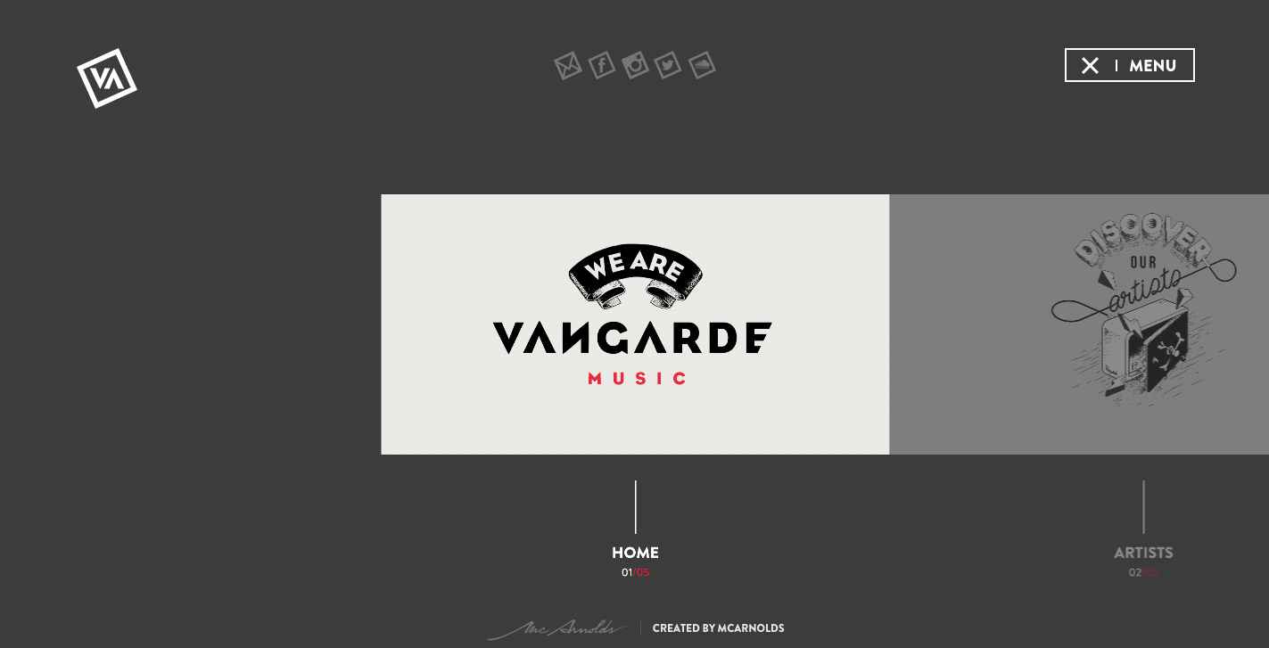
www.vangardemusic.com

Slide 28
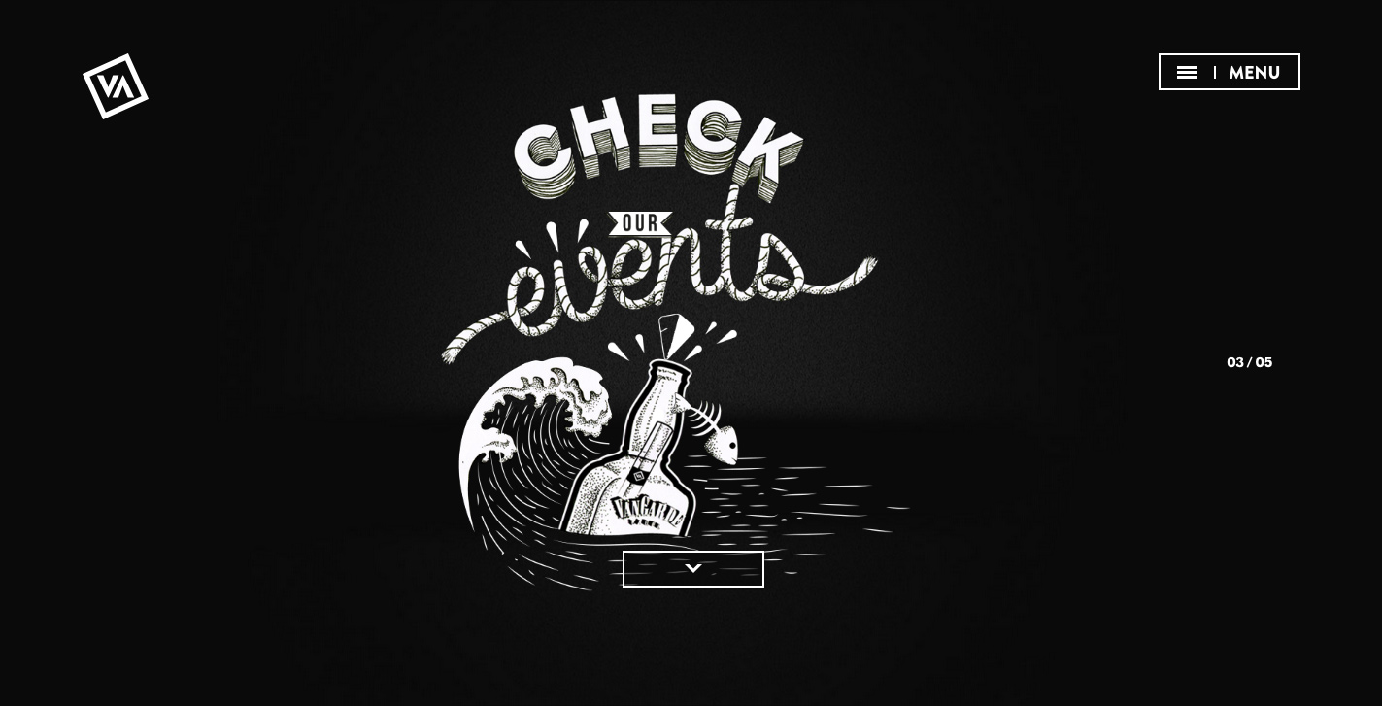
www.vangardemusic.com

Slide 29
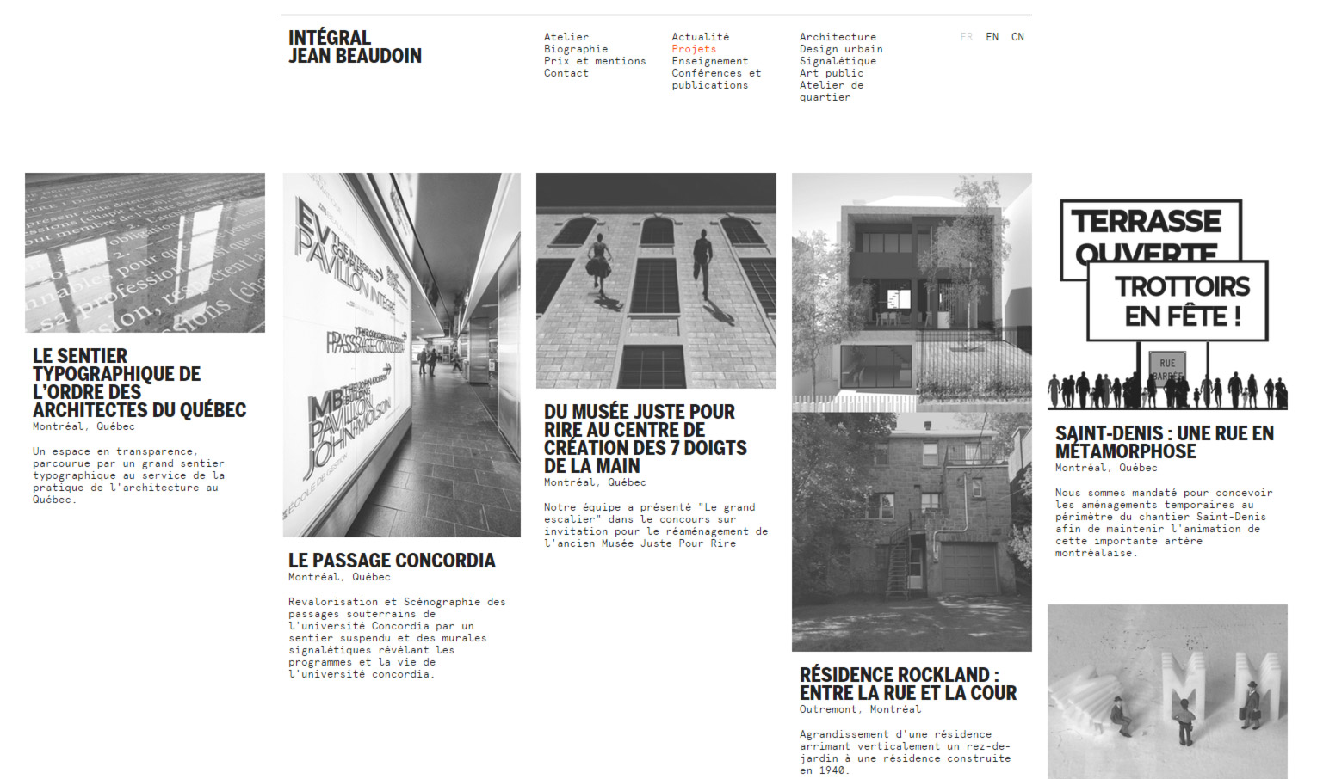
www.ijb.ca

Slide 30
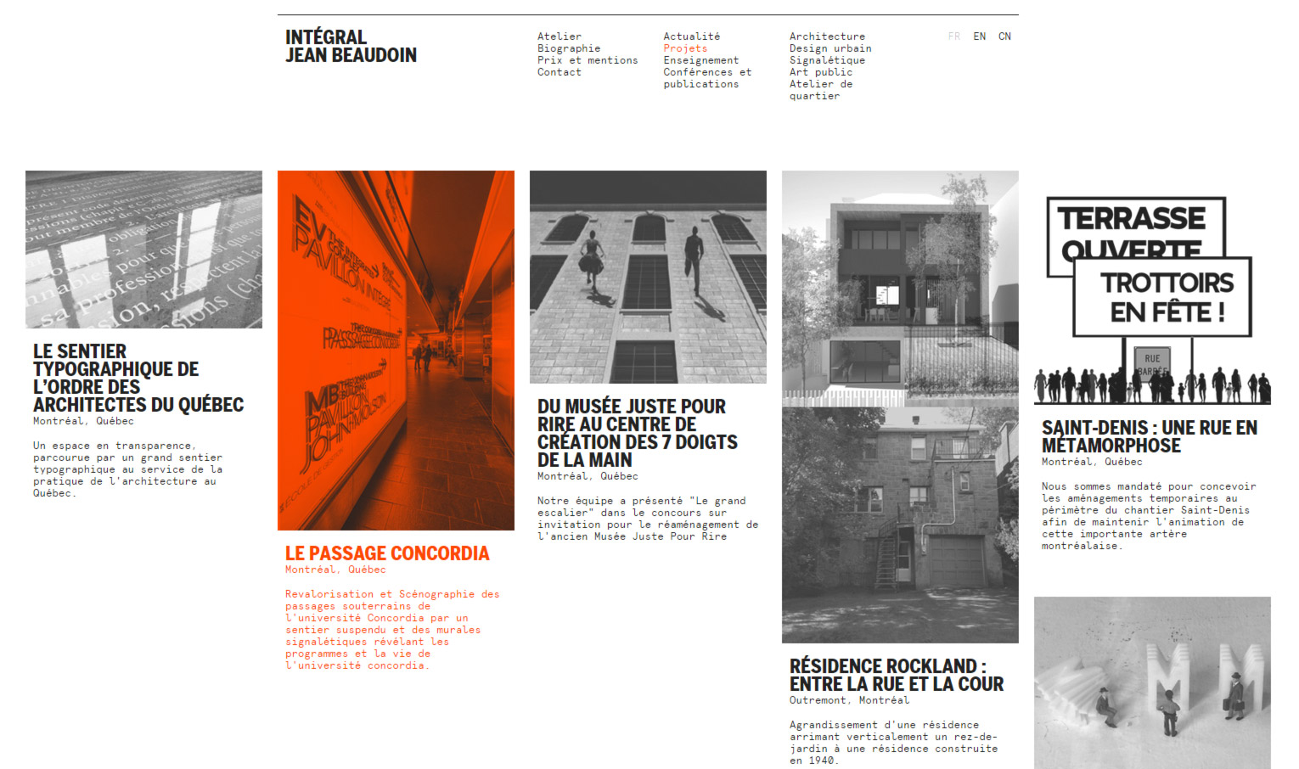
www.ijb.ca

Slide 31
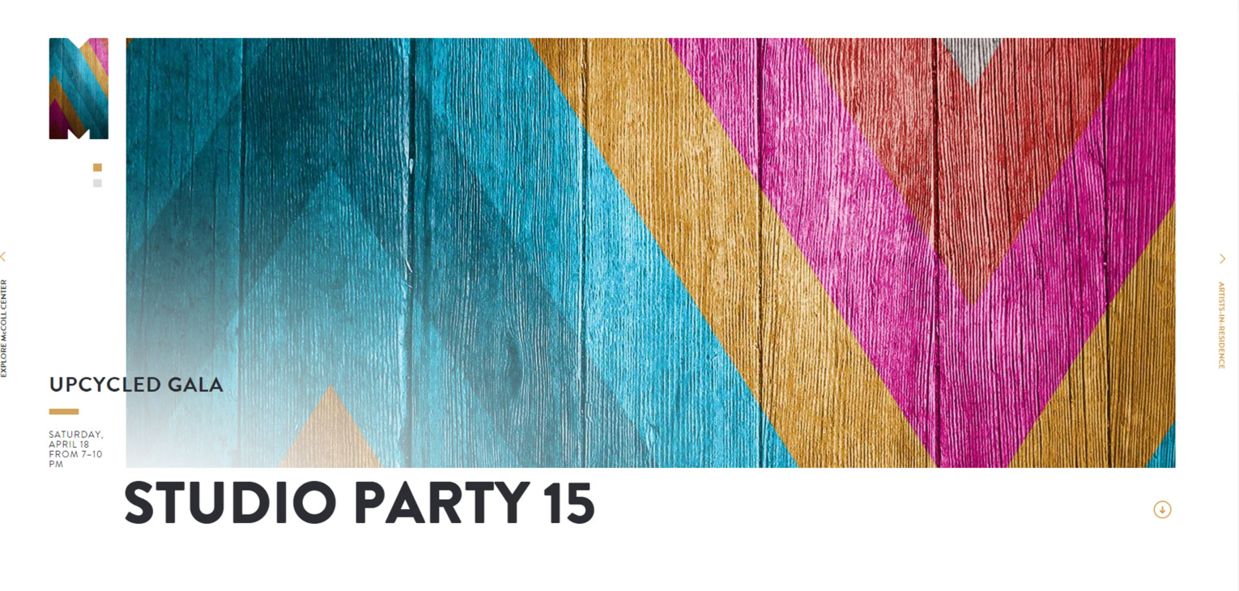
mccollcenter.org

Slide 32

mccollcenter.org

Slide 33
Typographic Web Design Examples
www.benoitchalland.com
www.akqa.com
oyafestivalen.com
superbalist.com
www.yuppiechef.com
norwegianrain.com
unitedstrands.com
simplygum.com
www.pelicanbooks.com
www.guilddesignfair.com
redbullkingoftheair.com
ff0000.com
www.cartelle.nl
www.buzzfeed.com/annehelenpetersen/nick-krolls-walk-in-the-park#.tcXoN7eK3j
Check out the links listed for examples of how typography can be applied to websites in various categories and how companies maintain their brand identities through the use of their web fonts.
Resources: www.typewolf.com/guides
www.fontshop.com

